Slide 1
Sentiment Analysis
Using TextBlob and Machine Learning Techniques
Garima Mahajan

Slide 2
Objective
Analyze customer review sentiment (Positive, Neutral, Negative) using Natural Language Processing (NLP) tools. It is a Multiclass Classification Problem

Slide 3
Steps
Data Preprocessing:
Checked missing values using .isnull().sum()
Loaded the dataset and inspected its structure using:
.dtypes to check the data types of each column.
.info() to review dataset size, column types, and null values.
Converted categorical features into numerical ones
Tokenization and Padding: The Tokenizer converted text data into numerical sequences.
The pad sequences function ensureed all sequences are of the same length (200).

Slide 4
Steps
2. Feature Engineering:
TF-IDF was used to convert the textual reviews (reviews.text) into numerical features suitable for machine learning models.
The TfidfVectorizer from sklearn was applied to the text data with the following configuration:
Maximum Features: Limited to the top 5000 terms based on their importance (highest TF-IDF scores).
TextBlob was used to compute the polarity of each review.
Polarity is a score ranging from -1 (negative) to +1 (positive), where:
- Positive Polarity (> 0): Represents positive sentiment
- Neutral Polarity (= 0): Represents neutral sentiment.
- Negative Polarity (< 0): Represents negative sentiment.
Based on the polarity score, a new column (sentiment) was created.

Slide 5
Steps
3. Handling Class Imbalance:
Applied SMOTE (Synthetic Minority Over-sampling Technique) to address class imbalance,
ensuring the model had enough data to effectively predict classes.
4. Exploratory Data Analysis (EDA):
Visualized the distribution of sentiment classes (Positive, Neutral, Negative) using Seaborn's countplot
Analyzed correlations and check for class imbalance.
5. Model Selection:
Splited the data into training and testing sets.
Trained models like SVM, LSTM, XGBoost, Neural Networks, Naïve Bayes
Tuned hyperparameters for best performance.
6. Model Evaluation:
Evaluated using metrics like Precision, Recall, and AUC-ROC.
Compared models and choose the best one.

Slide 6
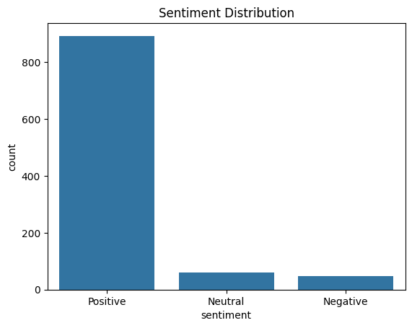
Exploratory Data Analysis
General Trends:
Class Balance
Positive class tends to dominate
Neutral and negative being the minority classes
Purpose of Derived Sentiment Feature:
- Enables classification models to leverage sentiment as a feature.
- Helps in understanding the overall sentiment distribution in the dataset.

Slide 7
Model Selection and Evaluation
Models Trained:
Trained multiple models, including Naive Bayes (NB), Random Forest (RF), XGBoost, Logistic Regression (LR), and Support Vector Classifier (SVC).
Evaluation Metrics:
Performance evaluated using metrics like Accuracy, Precision, Recall, and F1-score.
Final Model Selection:
- Naive Bayes was chosen as the final model due to its ability to:
Handle multiclass sentiment classification effectively.
Perform well with sparse TF-IDF features.
Deliver balanced performance across all sentiment classes.
Its computational efficiency and suitability for text-based tasks made it the most reliable choice for sentiment analysis.
Improvements:
- Models were hyperparameter-tuned for optimal performance.
- TF-IDF and derived sentiment features were key contributors to the model's success.

Slide 8
Modelling Results
Accuracy: 98%
The model correctly classified sentiment for 98% of the observations, demonstrating excellent performance in distinguishing between Negative, Neutral, and Positive sentiments.
The model demonstrated high precision and recall across all sentiment classes, ensuring accurate predictions with minimal false positives and negatives.
AUC-ROC Score: 0.9997 - The AUC-ROC score reflects an exceptional ability to distinguish between all three sentiment classes, confirming the robustness of the model.
Overall, the model is highly reliable for multiclass sentiment classification.

Slide 9
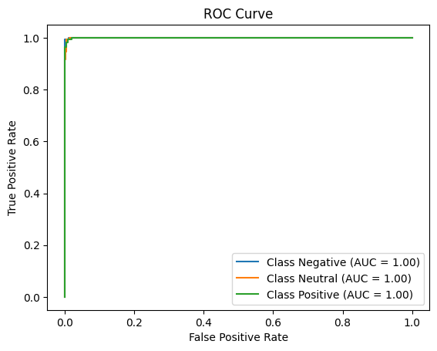
Insights
Perfect Classifier: An AUC of 1 means that the model perfectly distinguishes between the positive and negative classes for all threshold values. The model never makes a false positive or false negative prediction, making it a flawless classifier.
ROC Curve: The ROC curve plots the True Positive Rate (sensitivity) against the False Positive Rate (1-specificity) at various classification thresholds. A higher AUC indicates better performance, as the model's curve is closer to the top-left corner, where the true positives are maximized and false positives minimized.

Slide 10
THANK YOU!

